Slide 1

EVRT
Annual General Meeting
2nd September 2024

Slide 2
Agenda
  Chairman's Welcome & Introductions
  Apologies for Absence & Declarations of Interest
  Minutes of the AGM held for the financial year 2022-23
  Chair’s Report & Financial Statements for the financial year 2023-24
  EVRT Research Results and Strategy Update– presentation and discussion
  Opportunity for Questions

Slide 3
Chairman's Report
  Thanks go to...
  EPC for continued support.
  Councilor Dennis Booth for his support as County Councilor with grant allocations.
  Football Foundation and the FA for grant allocations.
  The EVRT EXEC board for their time and efforts to develop the facility.
  Our wonderful team at The KGV

Slide 4


Progress Check
Building Community through Health, Recreation and Wellbeing
  Major renovations of the village room, a flexible space that hosts community clubs including for Art, Sewing, Social groups, Local History, Wellbeing clases
  A 6-year investment programme in our sport’s pitches, supported by Football Foundation.
  Installation of new climbing equipment in junior play area.
  New flat roof to changing rooms area and upweighted maintenance programme across the site.
  Introduction of "The Festival of Christmas”
  Two dedicated mental health practitioners operating from the Tranquility Room and a Women’s Wellbeing group.

Slide 5
Financial Review

Slide 6
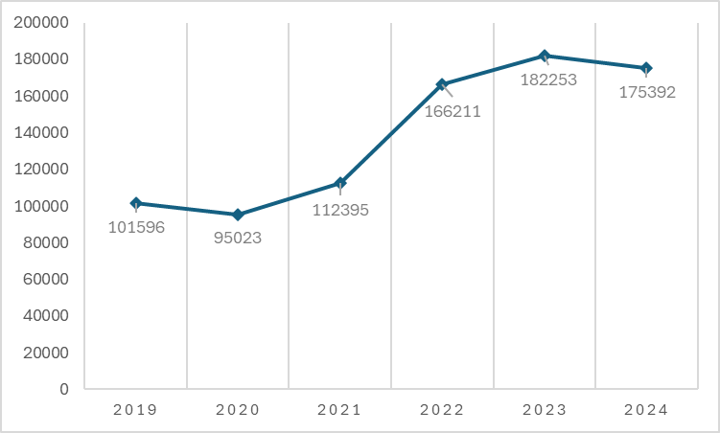
Our Cash Position is Stable
The charity now has a healthy cash position.
There are now sufficient funds in place to satisfy current and future liabilities, specifically to cover the required reserve requested by the Charity Commission.
EVRT is now able, with potential funding support, to invest in existing and new facilities.

Slide 7
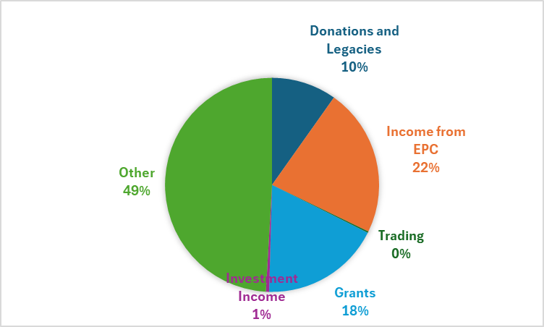
The Make-Up of our income in 2023 is more diverse.
Grants are increasing and now make up 18% of income
“Other” income is also increasing, generated by improved use of the facilities in terms of licenses and strengthening the significant community partnerships with local sports clubs, schools and other village groups.
EPC share has decreased almost 10% points in the last 3 years

Slide 8
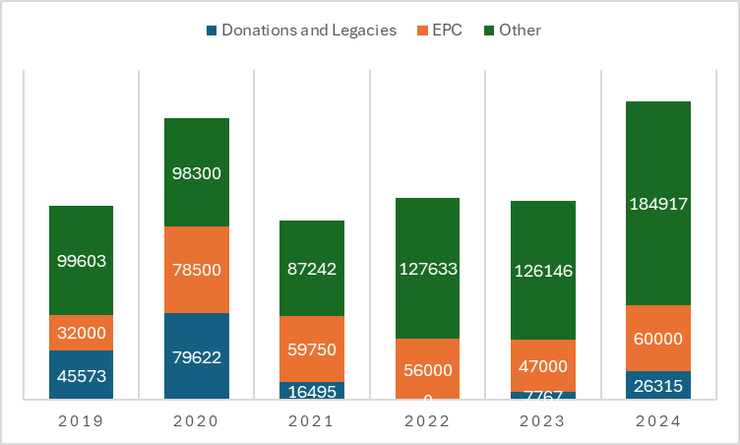
Income is rising and more sustainable.
"Other income" (from funding applications, licenses and user revenue) is slowly increasing.
Significant grants were secured in 2023/24, with the aim to continue in this manner.
A broader base of income.

Slide 9
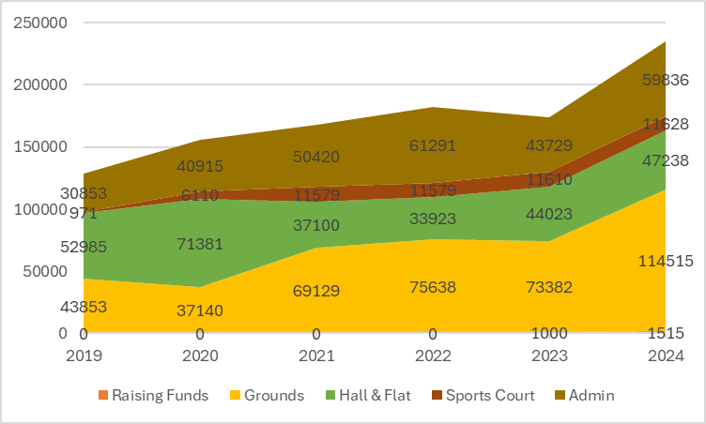
Rising income allows reinvestment in critical upgrades to the facility
Repairs and regeneration of existing facilities is now a priority.
Expenditure on ground maintenance such as clearing paths and hedges has increased.
Major repairs to roofs have been undertaken.
2023/24 has seen a large increase in costs across all services.

Slide 10
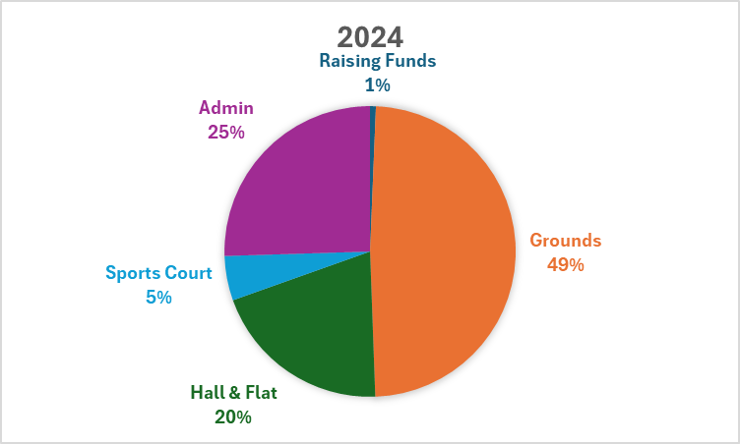
2024 Expenditure
Maintaining fit for purpose grounds and hall facilities incurs the largest proportion of our costs.
The overall expenditure for 2023/24 was supported via grants obtained from Football Foundation and Surrey County Council ‘Your Fund’.

Slide 11

What the Parish Council Funding Delivers
Infant & Toddler playground – maintained and regularly upgraded.
Access to 36 acres of woodland and open parkland with café, jogging trails and fitness equipment
Community club rooms for organised groups to meet and socialise
Indoor space for public meetings, exhibitions and displays
Outdoor and Indoor space for community celebrations

Slide 12
Survey Results

Slide 13
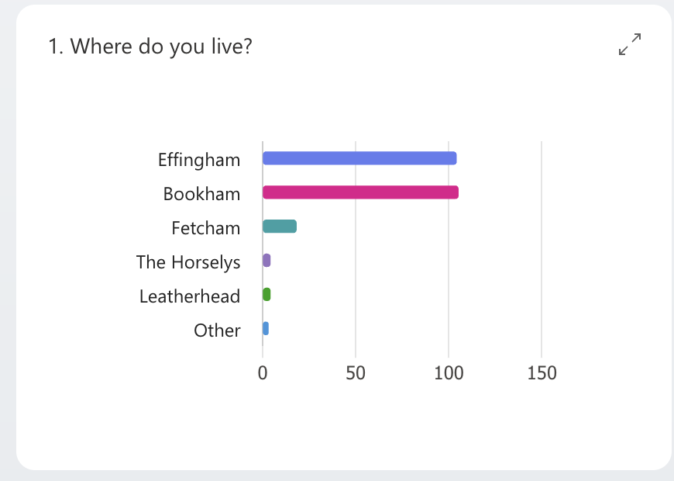
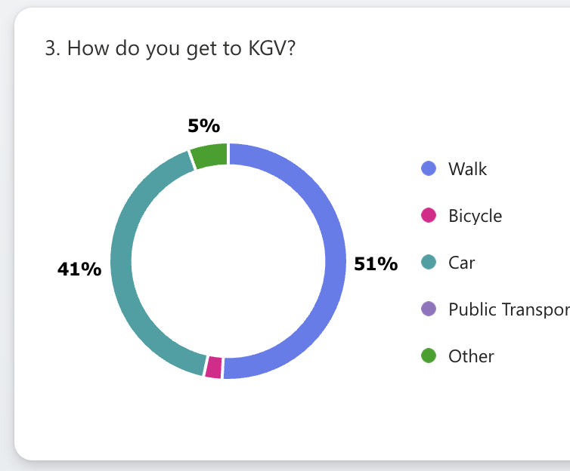
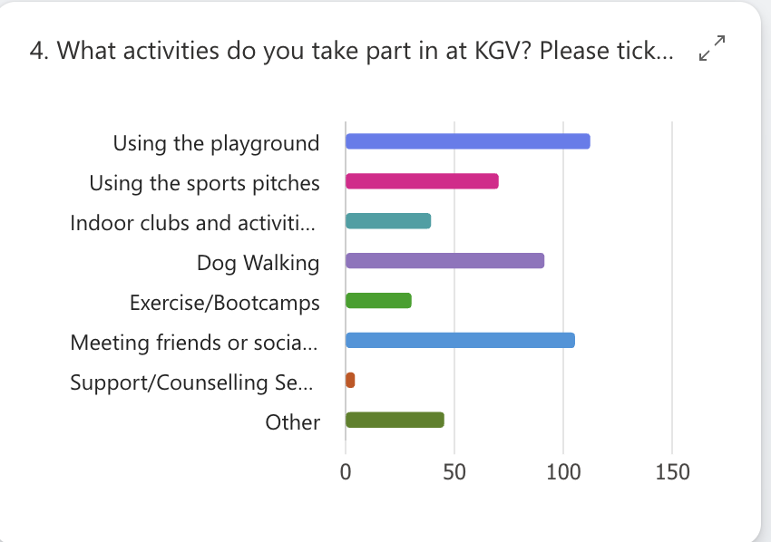

Slide 14
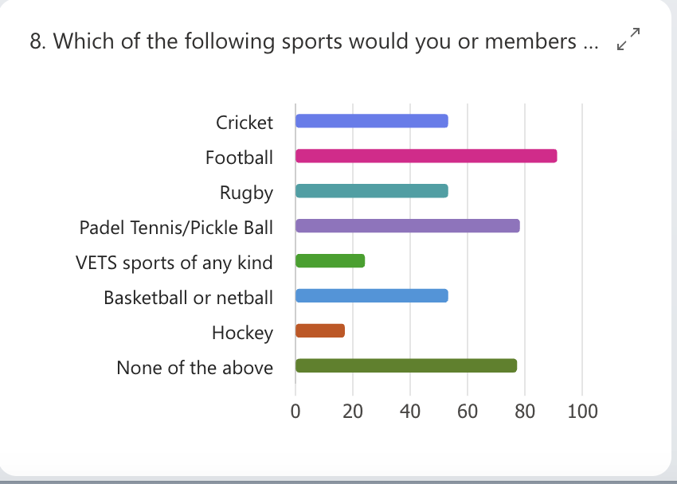
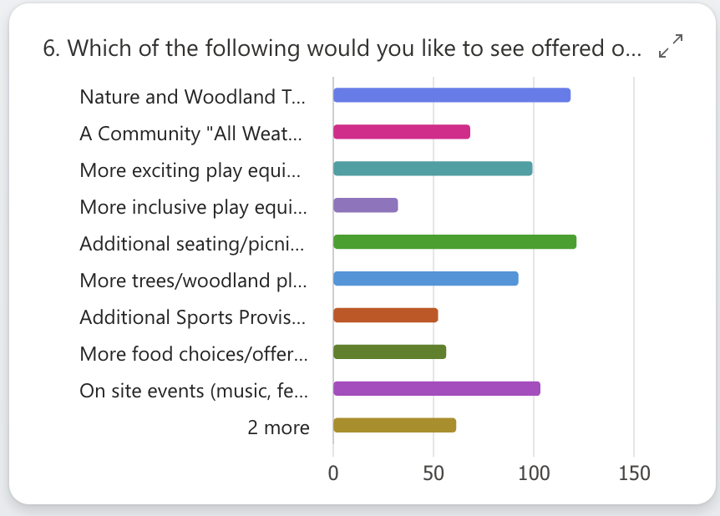
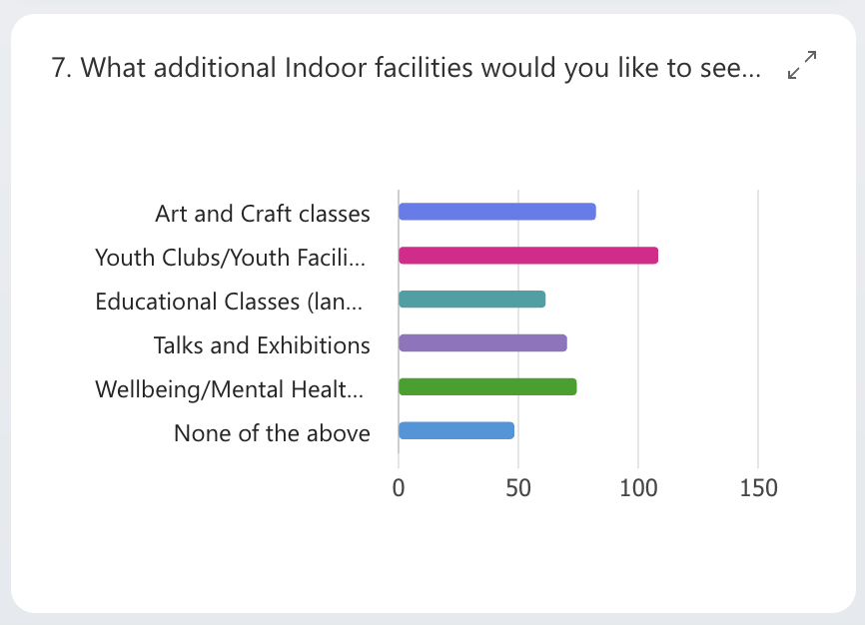

Slide 15

Challenges & Opportunities
1 in 4 residents come to the KGV to use the playground – need more higher quality opportunities for informal play & games
1in 10 residents struggle to gain access & there are currently no inclusive facilities
Families express concern about dogs but dog walking is a popular pastime at the KGV
There is latent demand for more indoor activities and outdoor events

Slide 16
Looking Ahead to Key Projects in 2024/25

Slide 17
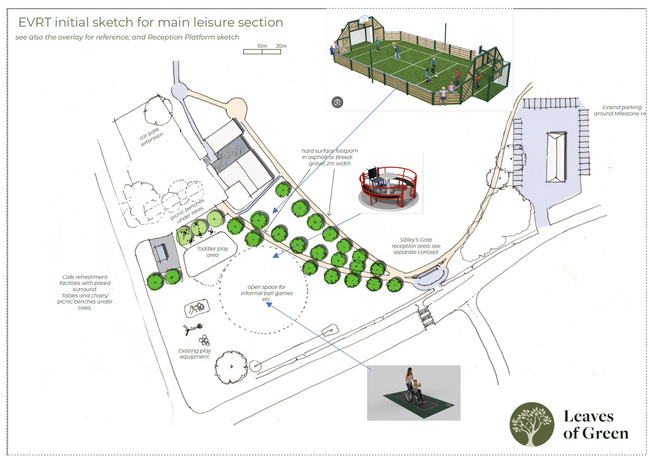
Community Play Zone for 2024/25
Inclusive Play Equipment.
Music and sensory zone.
Enlarged improved café and seating areas.
Community Multi-Use Games Area (MUGA)
  2x 5-a-side football
  Basketball court
  Pickle courts
  Free for community use post school and at weekends

Slide 18
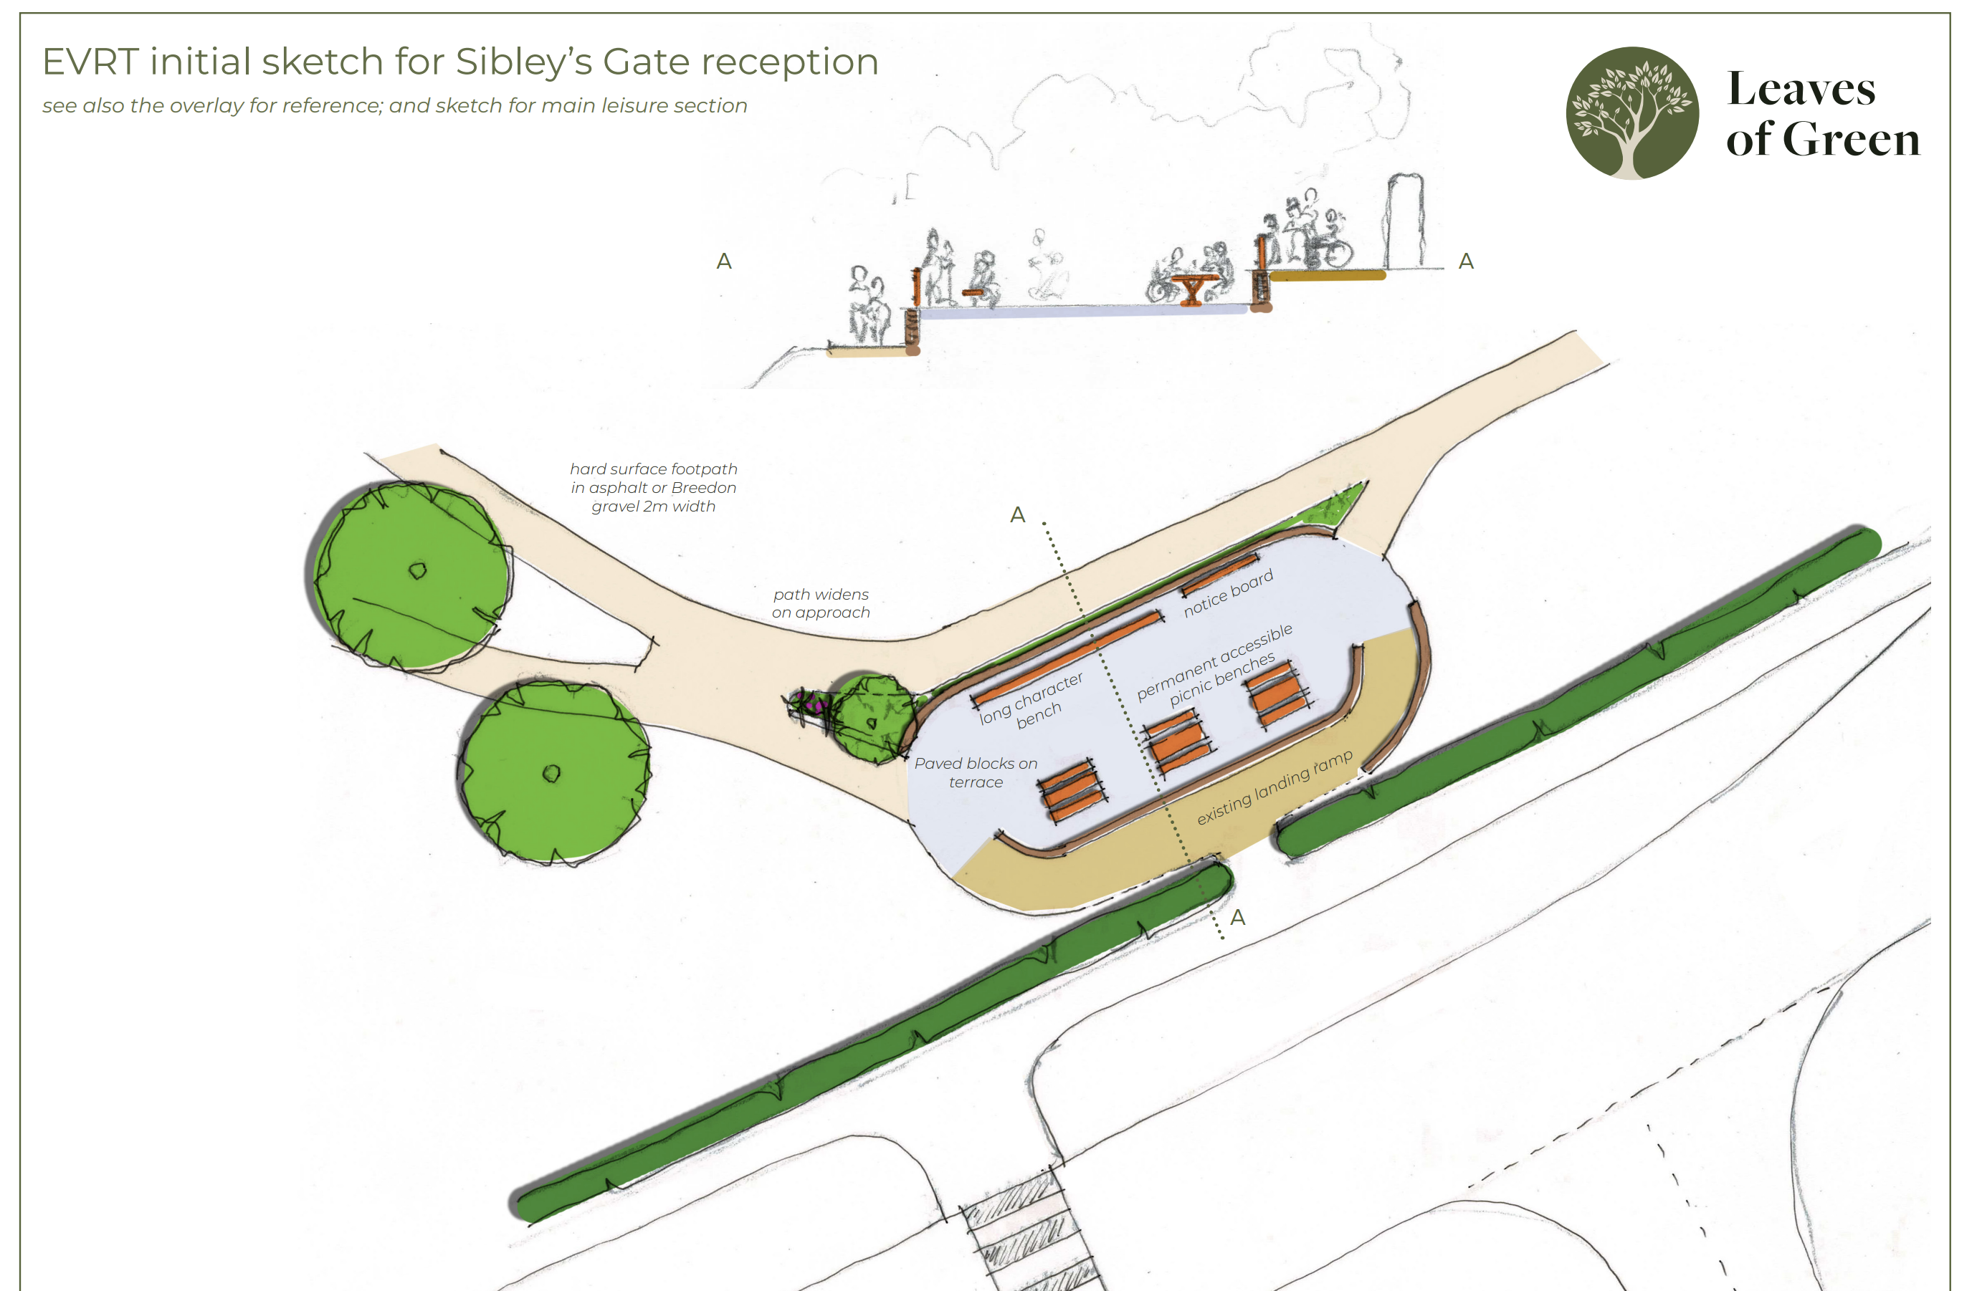
Accessible Terrace and Paths for 2024/25
Inclusive Access gate
Music and sensory panels.
Inclusive picnic benches
Accessible pathways to connect gate to main activity areas of the grounds.

Slide 19
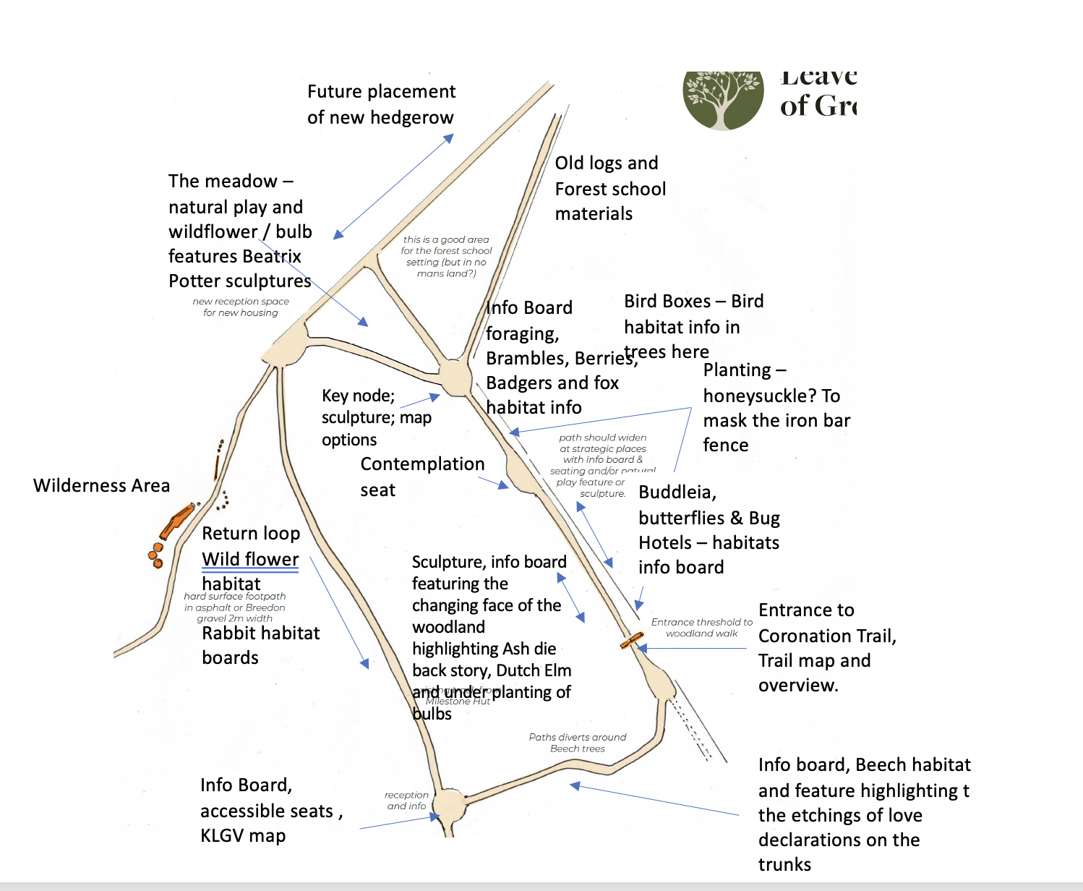
Coronation Natural Play & Habitat’s Trail
An accessible trail through our woodland areas
Art installations
Inclusive picnic benches and contemplation zones
Interactive natural play areas
Open ‘meadow’ and habitats trail.
Forest School

Slide 20
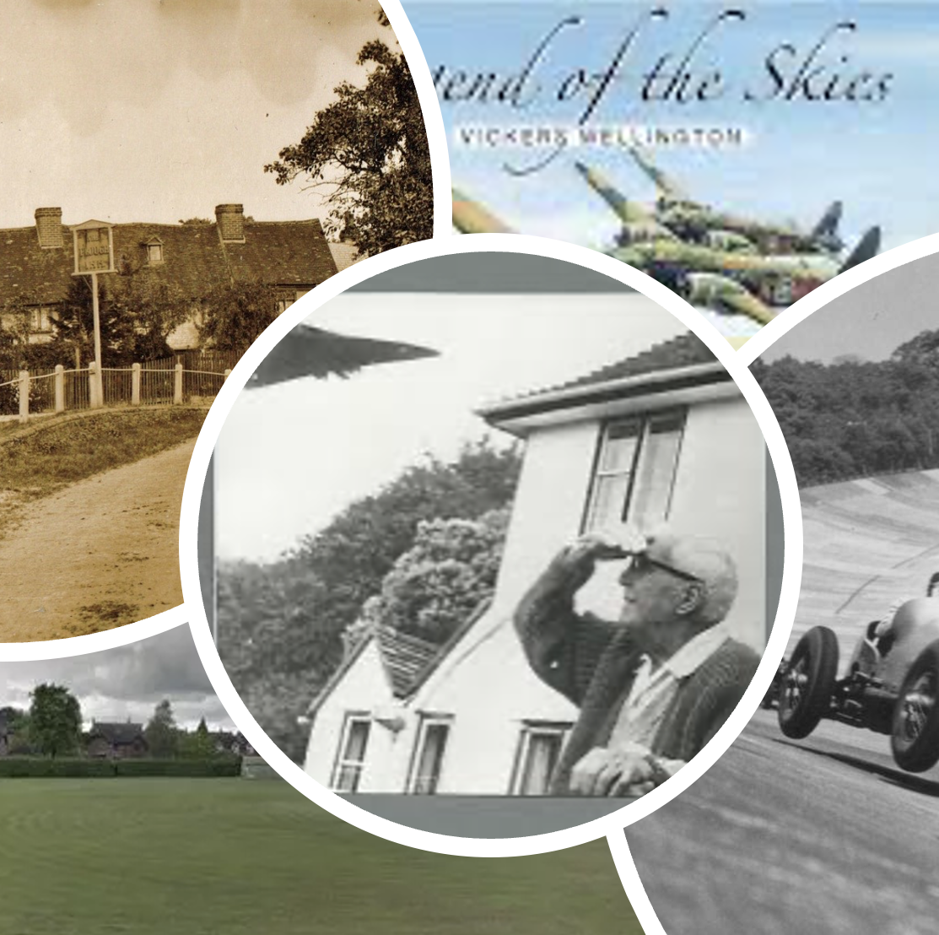
Community Heritage Centre 2025
Permanent Barnes Wallis exhibition
Local history from Saxons to stockbrokers
Effingham during the wars
Interactive and audio-visual exhibitions
Access to archives for research
Local History hub for shools
Photo credits: Effingham Residents Association

Slide 21

Questions?

